Slide 1
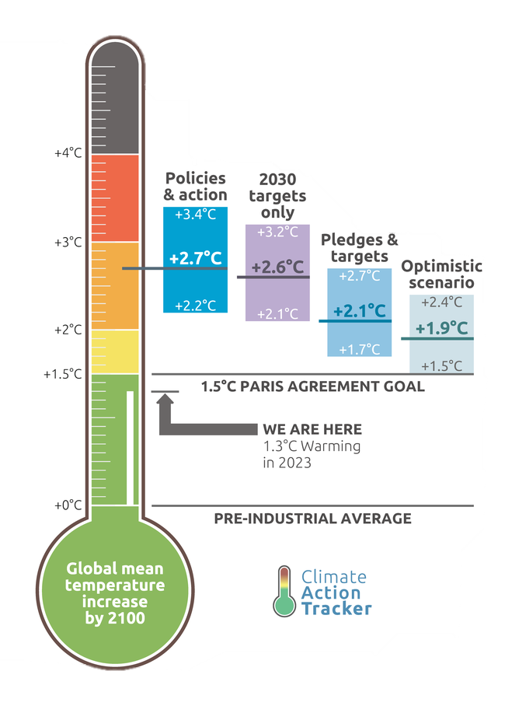
Plugging into progress
Evaluating power sector decarbonisation
for 1.5ºC
Climate Action Tracker
21 May 2025
www.climateactiontracker.org
Notes:
Thermometer version: Nov 2022 update

Slide 2
Defining Power Sector needs
Gustavo De Vivero

Slide 3
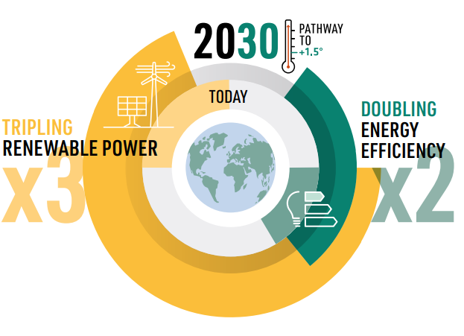





At COP28, governments agreed to triple global renewable capacity by 2030
Power sector decarbonisation is the cornerstone to decarbonise global economy and keep us within reach the Paris Agreement
Power sector is the largest emitting sector
RE power generation are a reality at scale and cost-competitive
RE-powered electrification and energy efficiency are the major decarbonisation solutions for end-use sectors
Globally, we committed at COP28 to triple total global renewable power generation capacity and double energy efficiency by 2030 (compared to 2022 levels)
Source: IRENA, Tripling renewable power capacity and doubling energy efficiecny by 2030: Crucial steps toward 1.5C

Slide 4
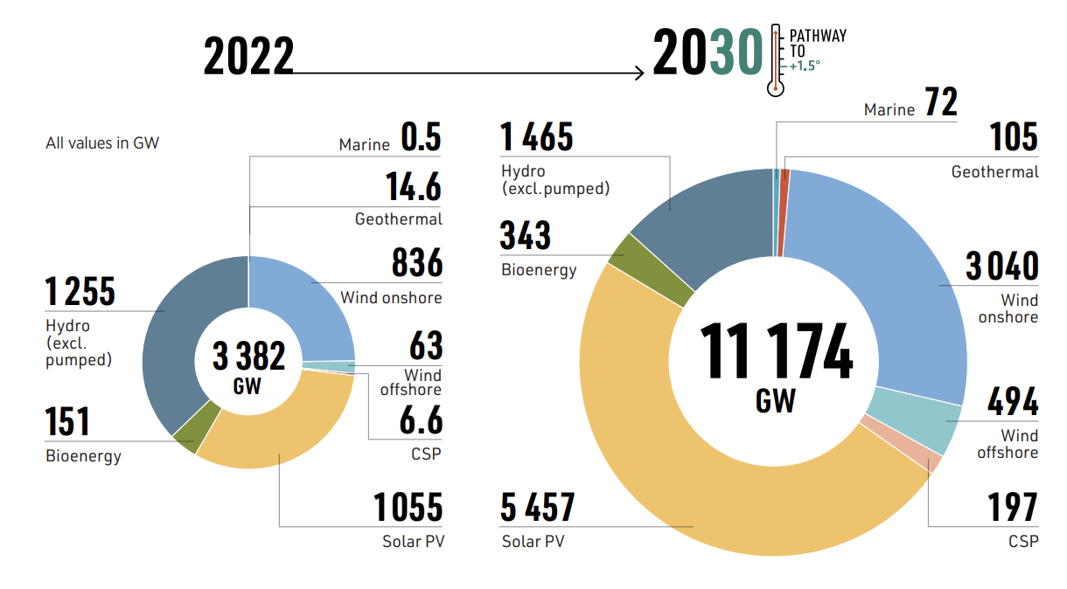

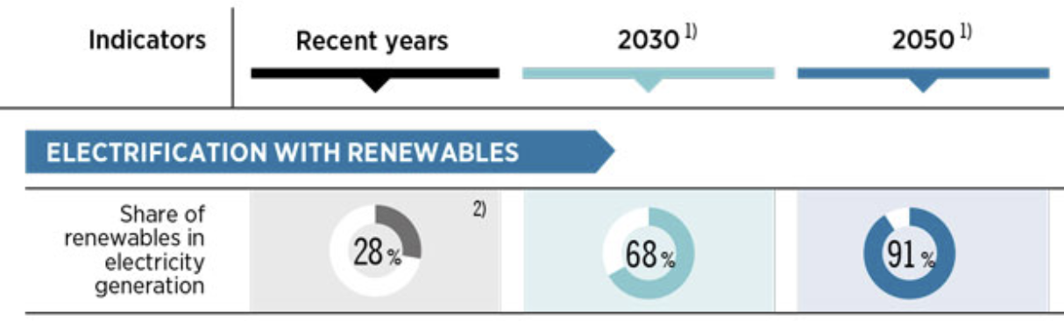
We need to understand the target beyond the GWs
What is behind the tripling RE target (~11000 GW by 2030)?
This target is in line to achieving net-zero emissions in the energy sector by 2050 (i.e., phase out fossil fuels in the power sector)
RE capacity additions need to accelerate: ~1000 GW additional RE power capacity is needed annually to stay on a 1.5C pathway
Electrification of end-use sectors drive demand growth: generation from renewables need to increase faster than demand growth
Wind and solar power are at key drivers of the tripling target
Speed and scale of growth will determine the likelihood to achieve the goal
0%
+GW
TWh
76%
⏳
Source: IRENA, Tripling renewable power capacity and doubling energy efficiecny by 2030: Crucial steps toward 1.5C

Slide 5
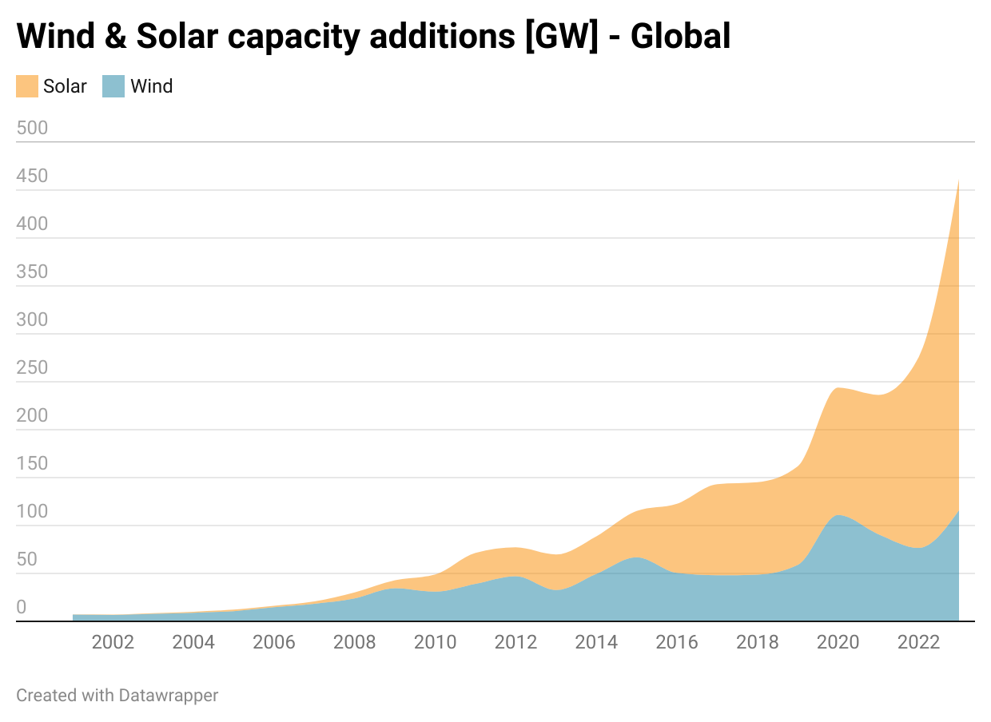
Renewables are expanding…
Global growth of renewable energy increased in pace over the last decade
Renewable power installations have grown exponentially in the last decade driven by technology developments and cost competitiveness
Wind and solar are the main technologies being installed, above fossil fuels
Share of renewables continue to grow year-by-year – led mainly by wind and solar
~1000 GW needed
Source: IRENA, Renewable Energy Capacity Statistics 2024
Notes:
Global annual renewable capacity additions increased by almost 50% in 2023, the fastest growth rate in the past two decades

Slide 6
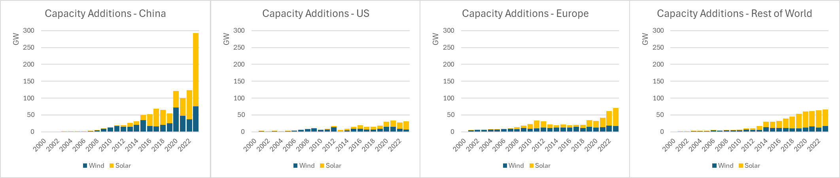
… but we are still far from where we need to be by 2030
More is needed and more evenly distributed across regions
Shares of renewables in power generation mix remain substantially low (~30% in 2023)
Annual renewable capacity additions need to at least double until 2030, compared to 2023 levels
Renewable massive deployment has been largely concentrated in China, and to lesser extent in Europe and US
More evidence is needed to break down the global renewable tripling target to national circumstances
Source: IRENA, Renewable Energy Capacity Statistics 2024
Notes:
Global annual renewable capacity additions increased by almost 50% in 2023, the fastest growth rate in the past two decades

Slide 7

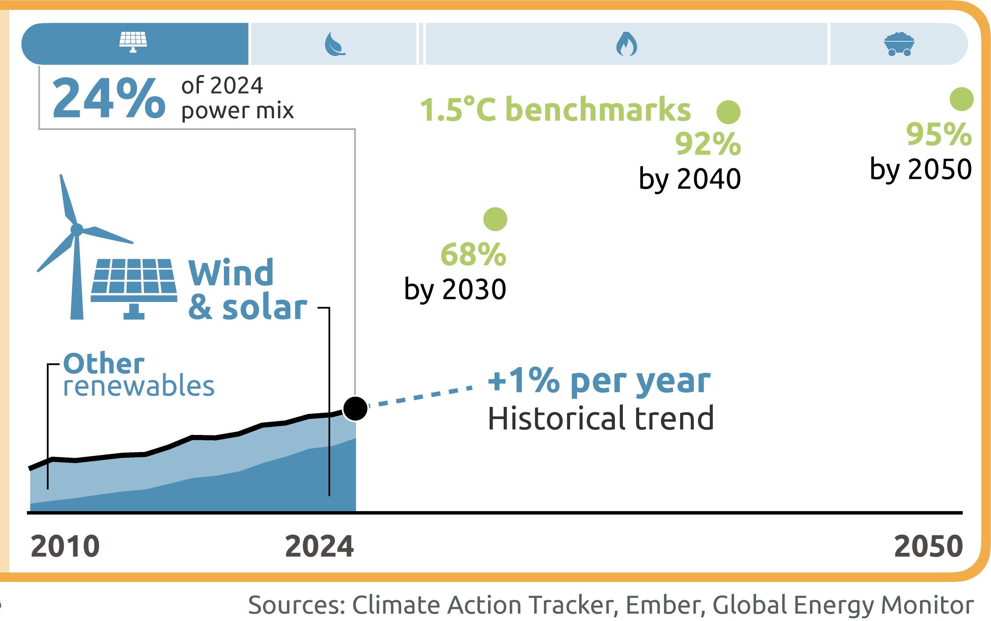

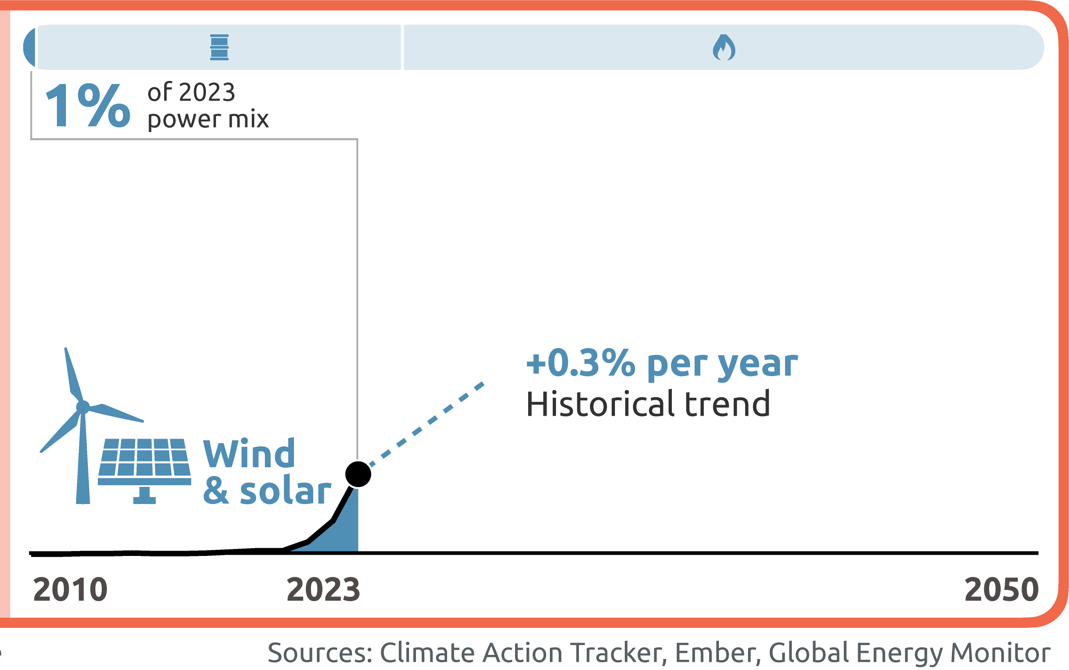
We need to translate the global tripling goal down to national level
We need country-level directional indicators
Action and implementation is ultimately done at national level
No ‘one-size fits all’: The power sector transition looks different in different countries
Benchmarks set the direction and need to be part of a broader call for action
While the benchmarks offer a useful starting point, they should not be interpreted in isolation
      On a global scale, benchmarks are useful to call for ambition and diplomacy
      At national level, the benchmarks should be used in the context of the status of the country's energy transition
      Country policy landscape is fundamental to layout feasible and ambitious decarbonisation pathways.
Notes:
No ‘one-size fits all’: The power sector transition looks different in different countries
Some countries have already started, some are only starting
Current generation mix conditions the transition (e.g., role of hydropower and other carbon-free technologies)
Equity considerations must be factored in (international finance and speed)
Not all countries would need to triple.

Slide 8


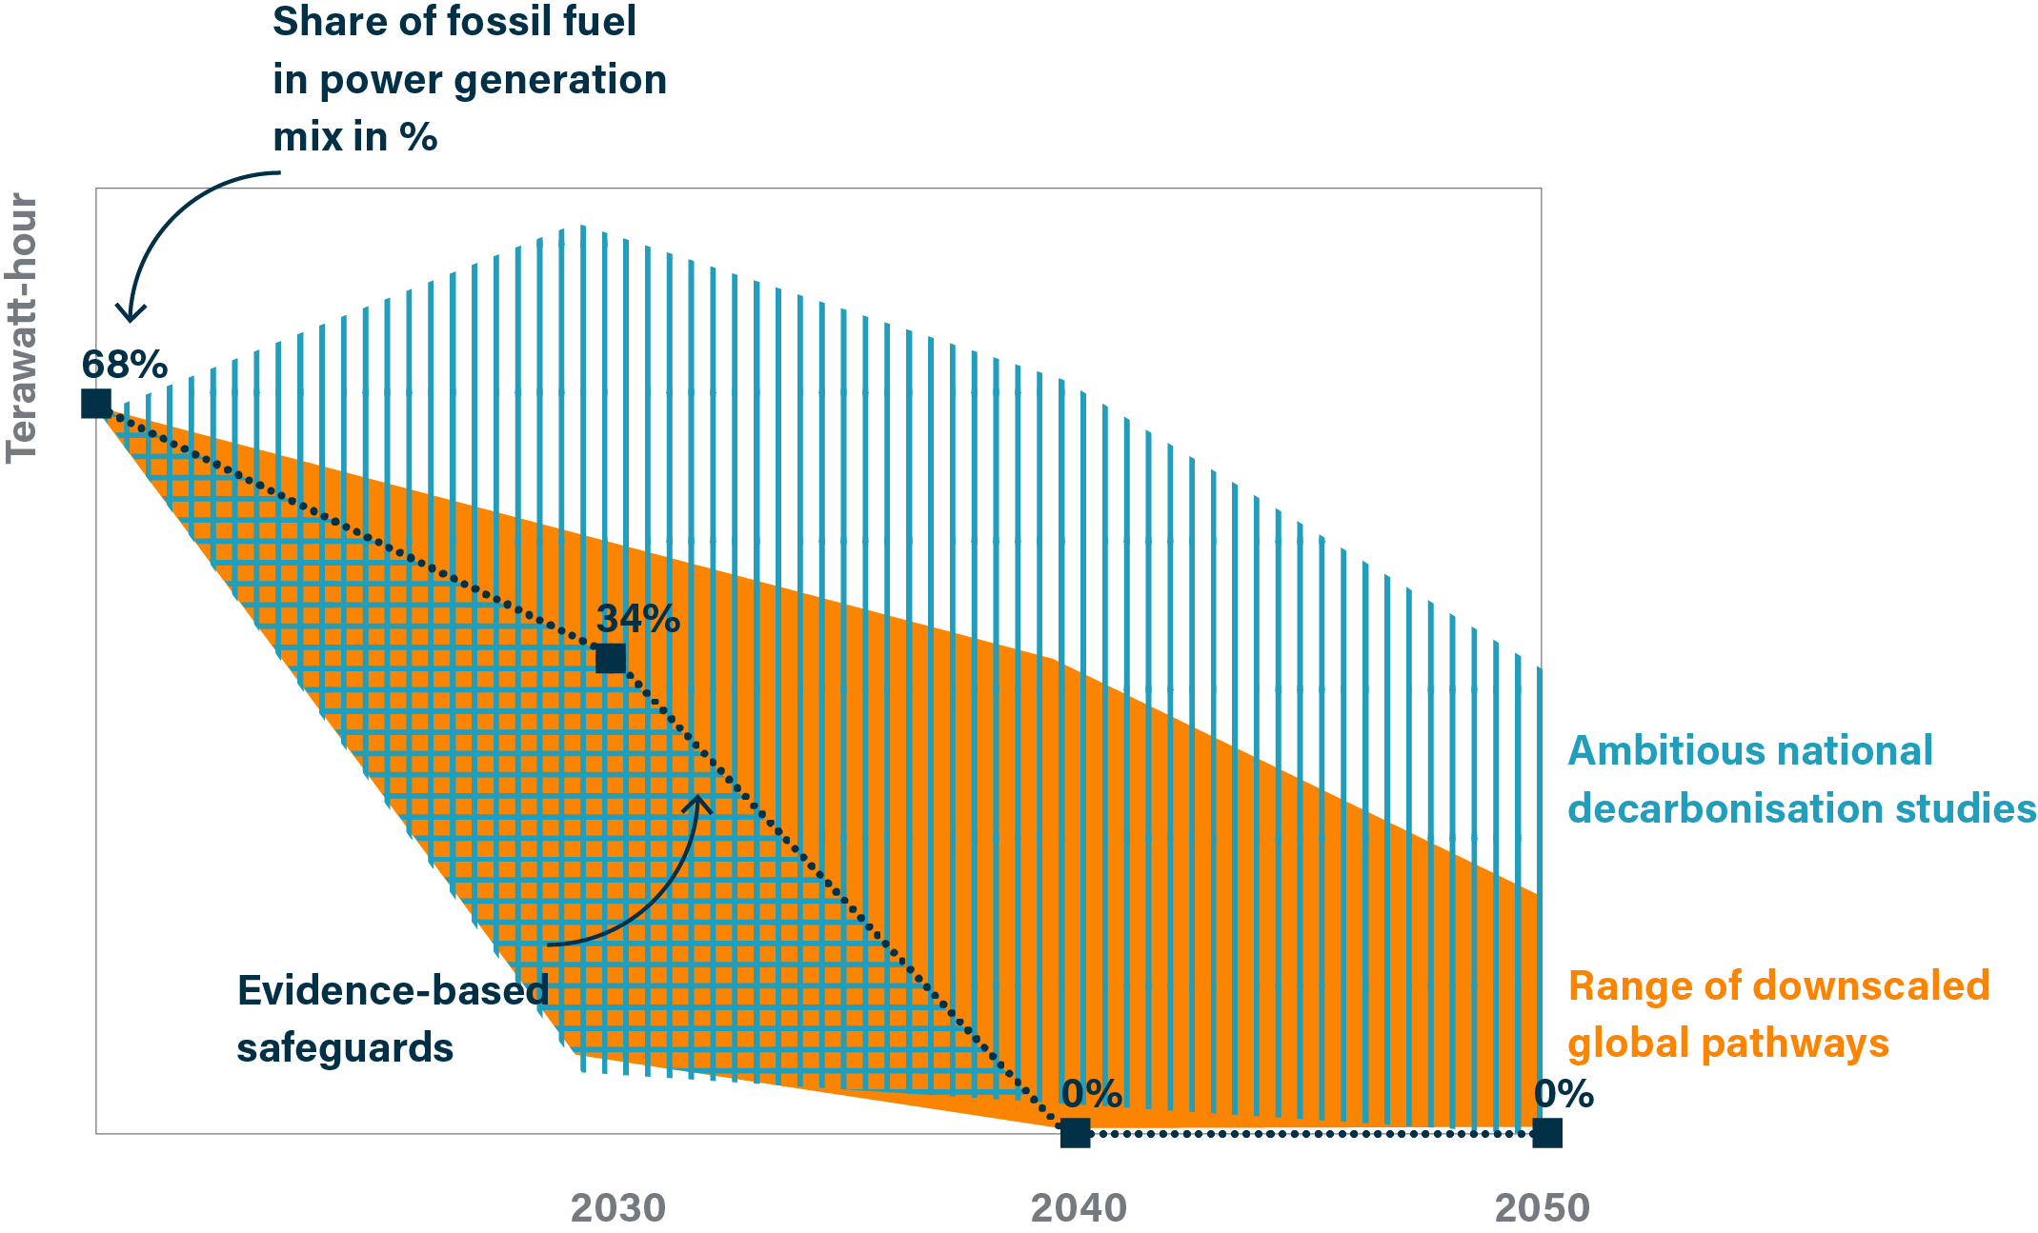



Our method is focused on including multiple analytical elements
Overlapping multiple lines of evidence provide more robust benchmarks
High-ambition country-level studies
Use ambitious country-level studies as inputs to inform key parameters
of the methodology
1.5°C compatible IPCC global pathways
Link to global goal of tripling renewable capacity by 2030
Integrating multiple lines of evidence
RE potential and power system analysis
Capture local potential for wind and solar
Key global milestones
Include key global guardrails on the pace of fossil phase-out and the level of electrification

Slide 9
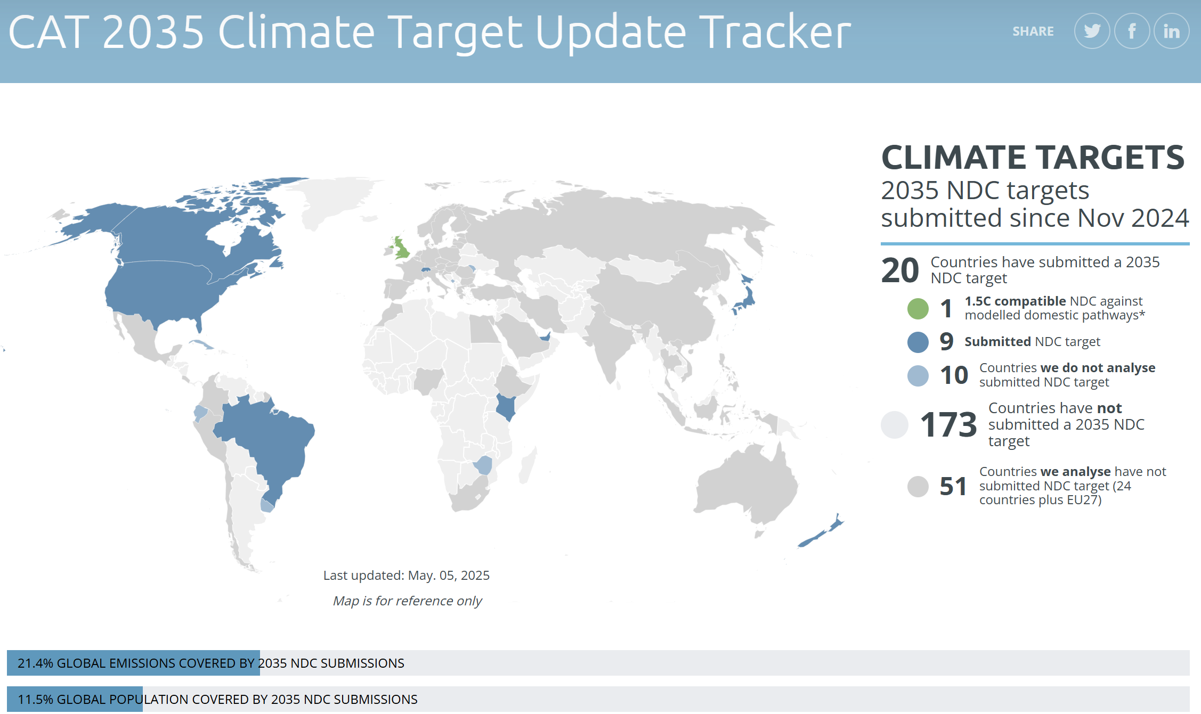
New NDCs should be ambitious, fair, credible and transparent
Ambitious NDC with explicit RE targets are needed towards tripling global renewable capacity
Current pledges fall short
Only a few countries explicitly lay out renewable capacity ambitions in their current NDCs
In general, we are off-track
This is all about ambition, but we need delivery
How do we get on track? We need everyone on board: Governments, policies, the industry, public support, finance.
The window is getting narrow and the transformation needed is still ahead of us.
Source: https://climateactiontracker.org/climate-target-update-tracker-2035/

Slide 10
New Power sector evaluation
Sarah Heck

Slide 11
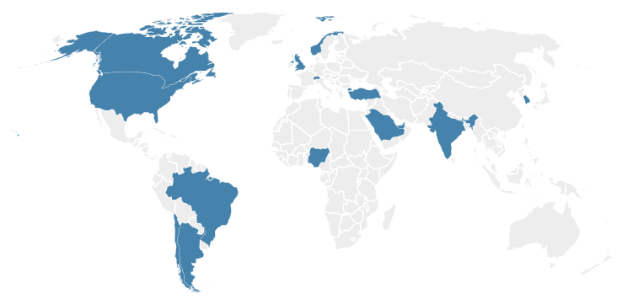

New CAT evaluation of the power sector for 16 countries
Our goals
Identify where things are going well and what we can learn.
Identify where things are not going so well so that action and resources can be directed there
Notes:
Overall approach – brief recap of key points from Gustavo’s presentation
CAT looks at progress toward fossil fuel phase out and renewables scale-up for individual countries.
Goal – identify where things are going well and what we can learn; identify where things are not going so well so that action and resources can be directed there.
16 CAT countries: Argentina, Brazil, Canada, Chile, EU, India, Nigeria, Norway, South Africa, South Korea, Saudi Arabia, Switzerland, Türkiye, UAE, UK, USA.

Slide 12
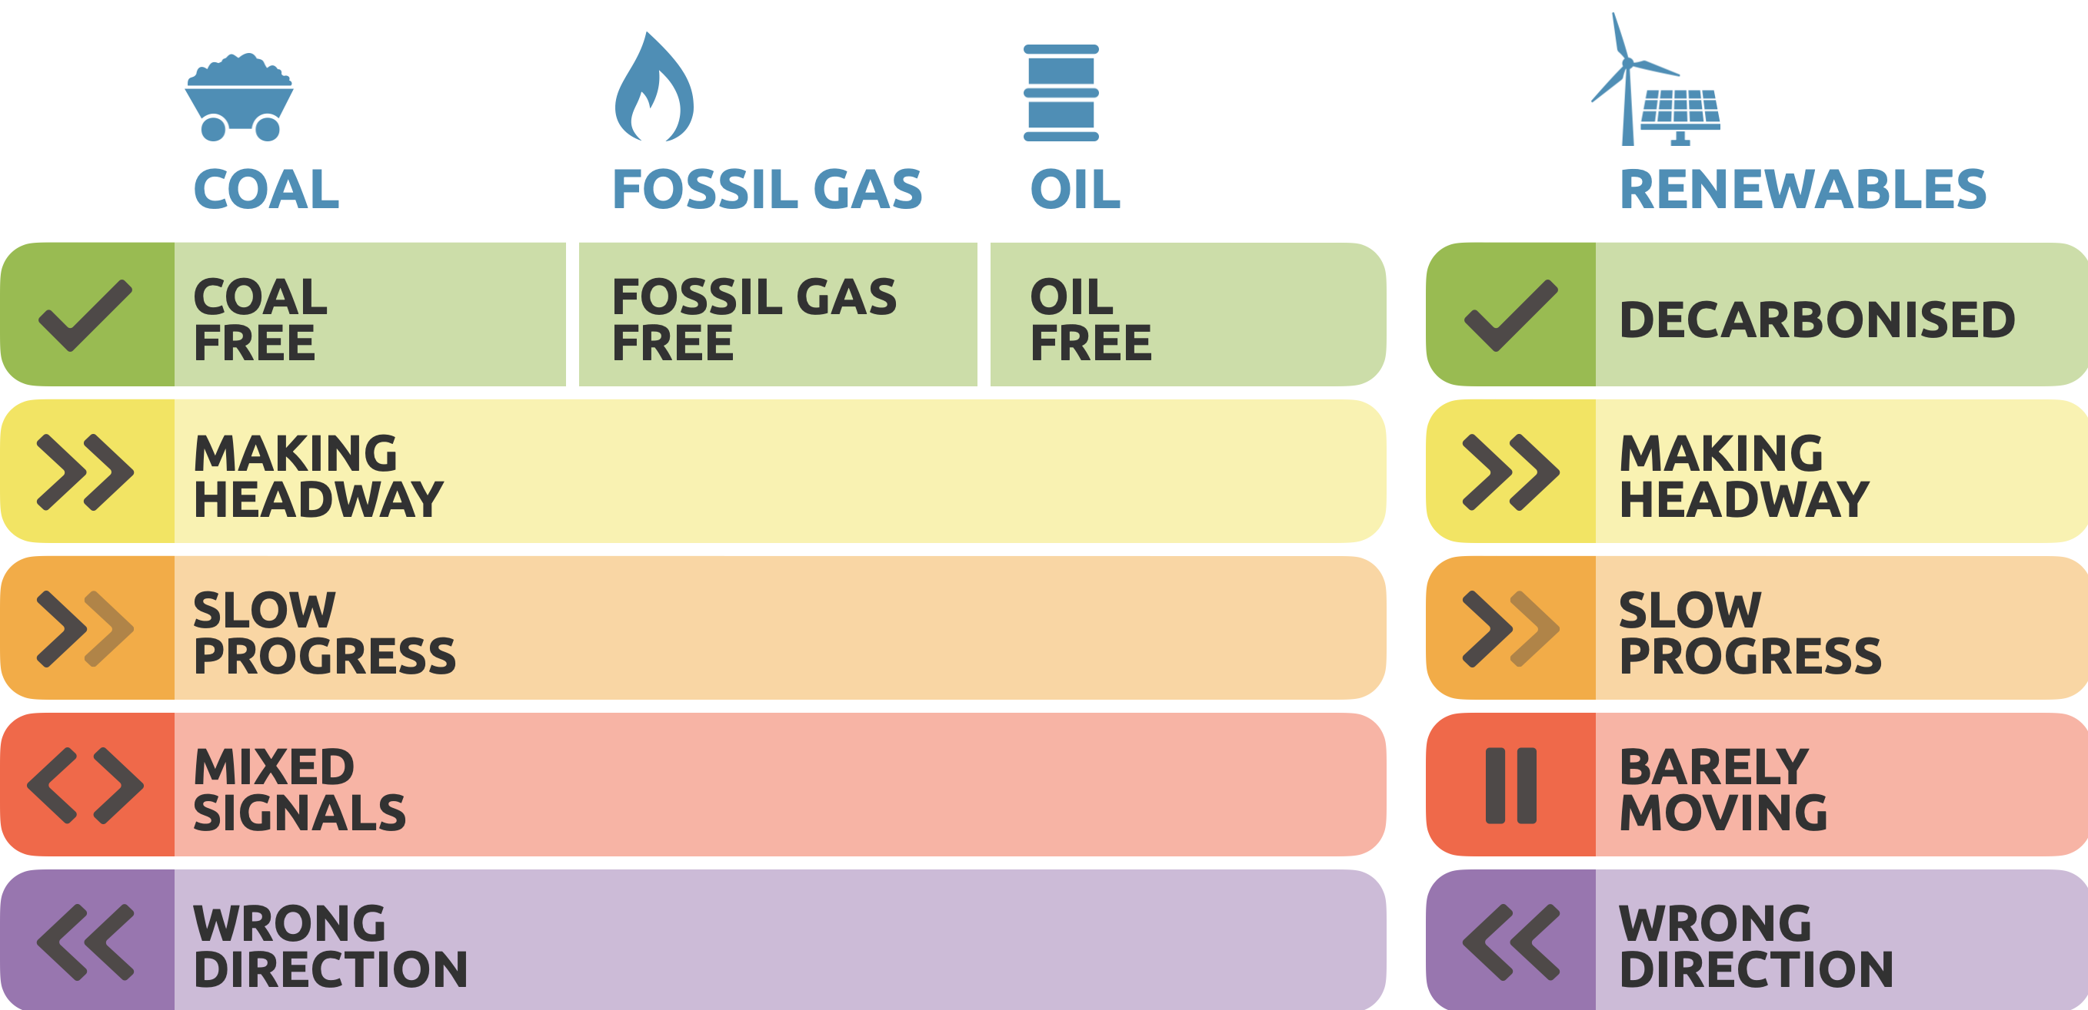
CAT Power sector evaluation
Notes:
3 energy sources: coal, fossil gas & renewables. We analyse oil in a similar way to coal and fossil gas for those countries where the contribution to overall power generation is greater than 5%. In a few CAT countries, including Bangladesh, Pakistan, Saudi Arabia, and Senegal, oil is a commonly-used fuel source for power generation.
Wrong direction - Policies and actions are heading in the wrong direction with no indication of change coming.
Mixed signals (Coal, Fossil gas & Oil) | Barely moving (RE) - Inconsistent or contradictory actions across the metrics evaluated.
Slow progress - Some progress, but far too limited or slow.
Making headway - Solid, consistent, forward movement.
Coal / Fossil gas / Oil free | Decarbonised (RE) - Clear frontrunners that have either completely removed this fossil fuel from their power system or never included it.

Slide 13
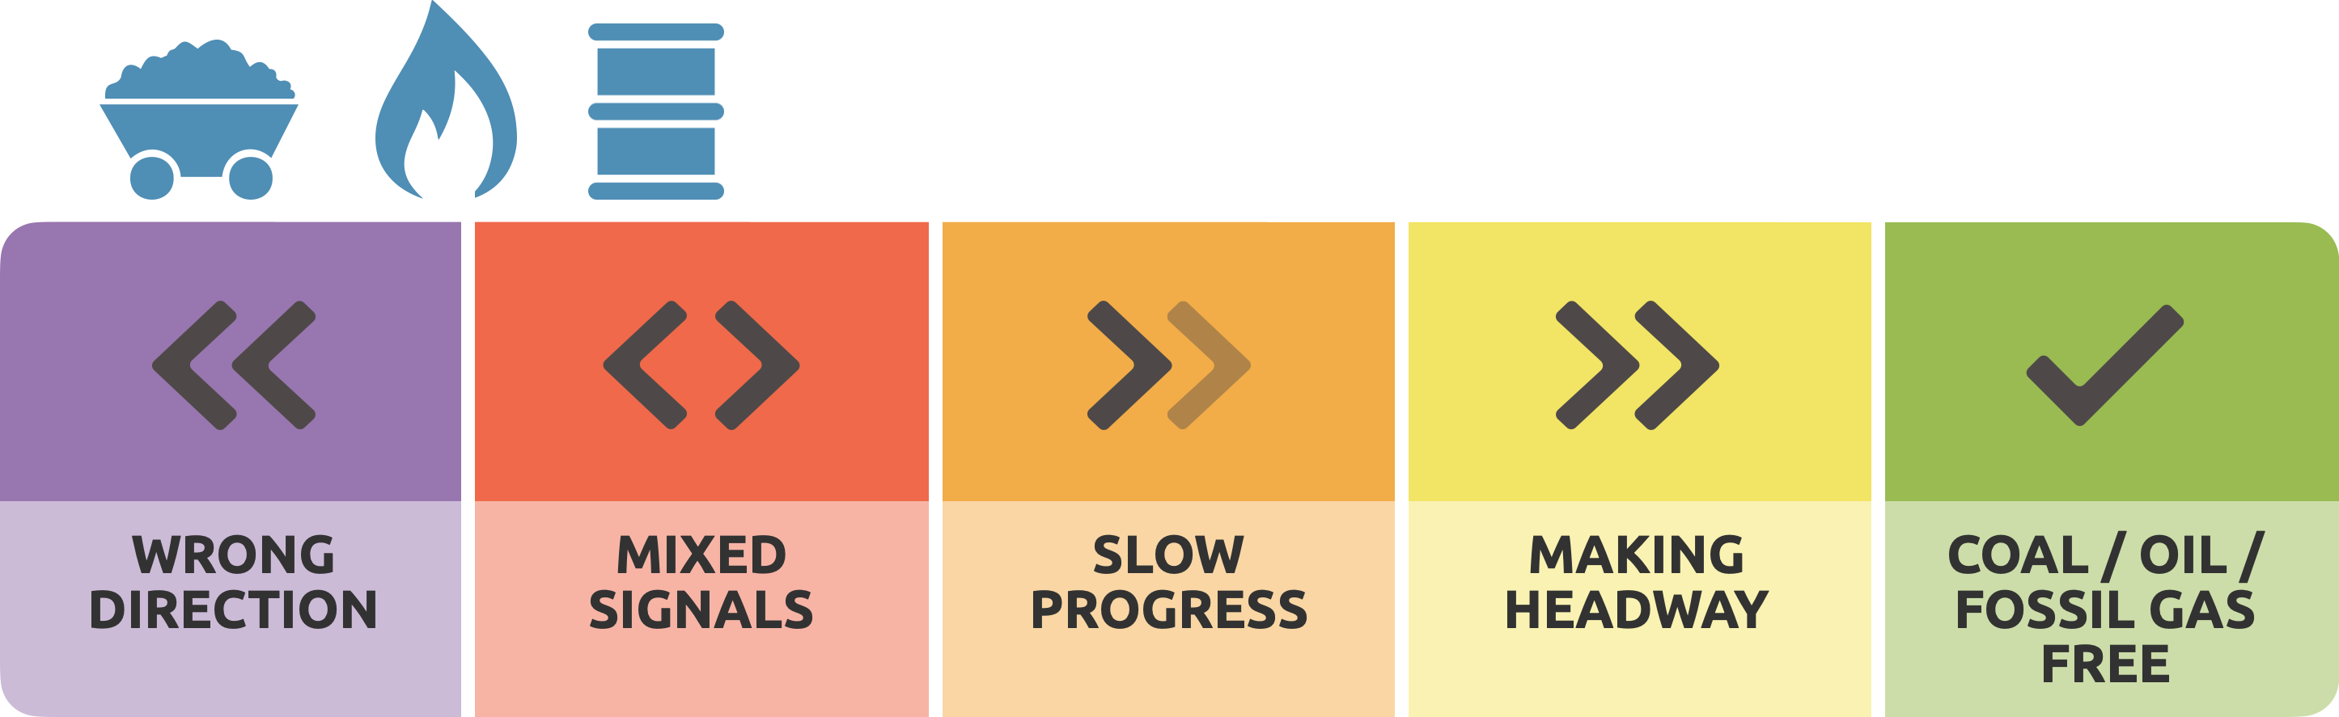
Our power sector evaluation system
Evaluation elements for fossil fuels
What has been the trend in power generation over the last five years?
Does the government have a 1.5˚C aligned target to phase out coal/fossil gas/other fossil fuels?
Is the government planning to construct new capacity?
Has the government enacted new policies that are likely to lead to a significant change in direction in the near term?

Slide 14
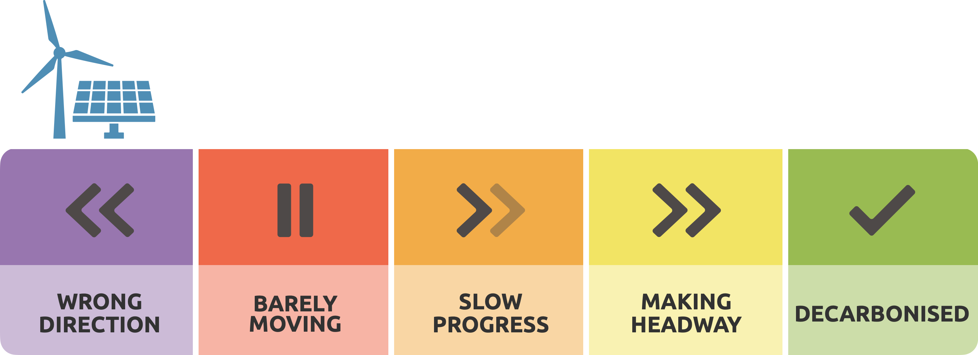
Our power sector evaluation system
Evaluation elements for renewables
What is the current share of all renewables in the power generation mix?
Historical trends - how quickly are wind and solar generation increasing?
Has the current government enacted policies that are likely to lead to a significant change in direction in the near-term?

Slide 15

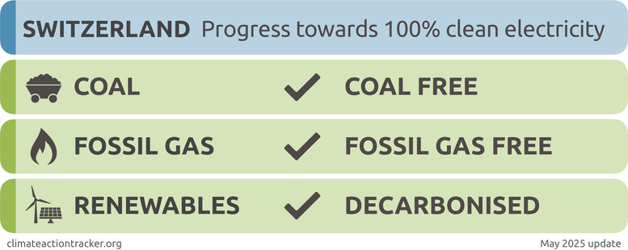
Switzerland
No coal in power generation, less than 1% of gas, nuclear and renewables add up to a combined >95% of generation
No evaluation for nuclear
Notes:
Although nuclear electricity generation does not emit CO₂, the CAT doesn’t see nuclear as the solution to the climate crisis due to its risks such as nuclear accidents and proliferation, high and increasing costs compared to alternatives such as renewables, long construction times, incompatibility with flexible supply of electricity from wind and solar and its vulnerability to heat waves. Our analysis therefore focuses on the shift toward a wind and solar based power system.

Slide 16
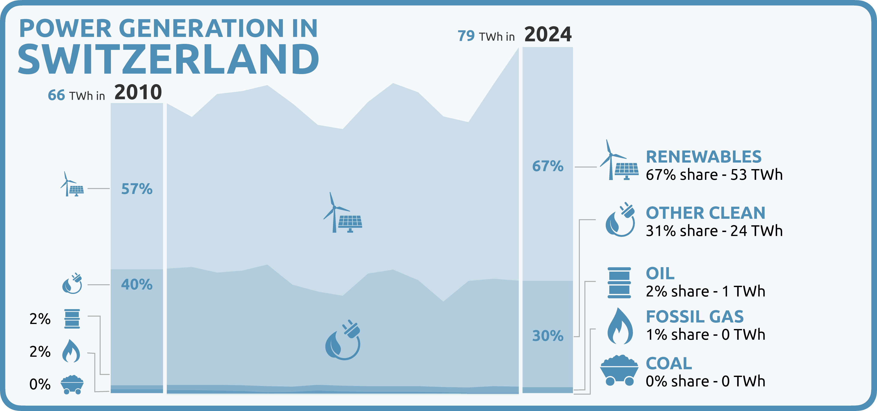
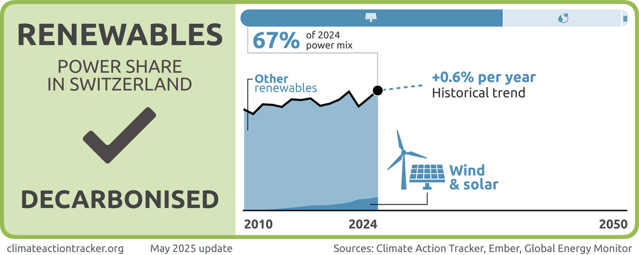
Switzerland
Fossil gas consistently below 1% in the last 5 years and no plans for additional capacity
Renewables accounted for 67% of electricity mix in 2024, hydropower at 57%. Wind and solar increasing but needs to be faster to enable further electrification
Nuclear and renewables add up to a combined >95% of generation, we also evaluate the country as “decarbonised”
CAT doesn’t see nuclear as the solution to the climate crisis
Notes:
Although nuclear electricity generation does not emit CO₂, the CAT doesn’t see nuclear as the solution to the climate crisis due to its risks such as nuclear accidents and proliferation, high and increasing costs compared to alternatives such as renewables, long construction times, incompatibility with flexible supply of electricity from wind and solar and its vulnerability to heat waves. Our analysis therefore focuses on the shift toward a wind and solar based power system.

Slide 17

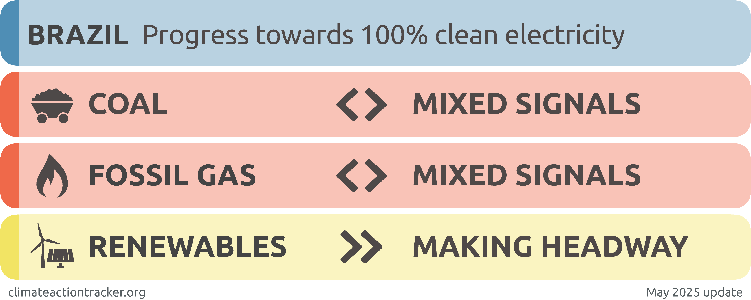
Brazil
Brazil’s power sector dominated by renewables at 88% in 2024

Slide 18
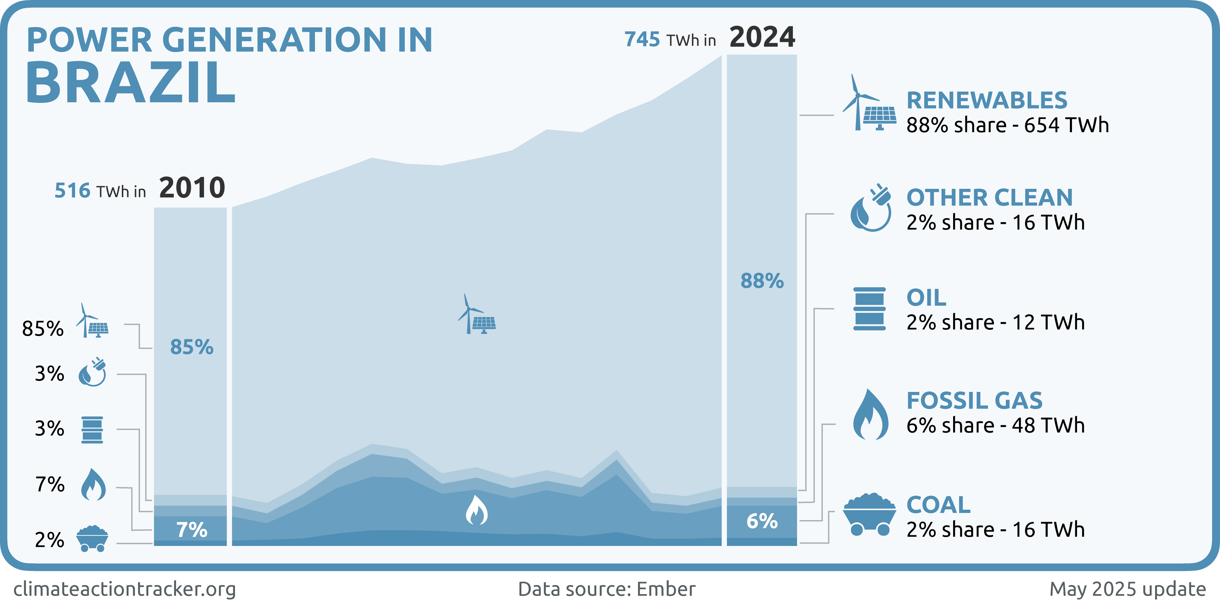
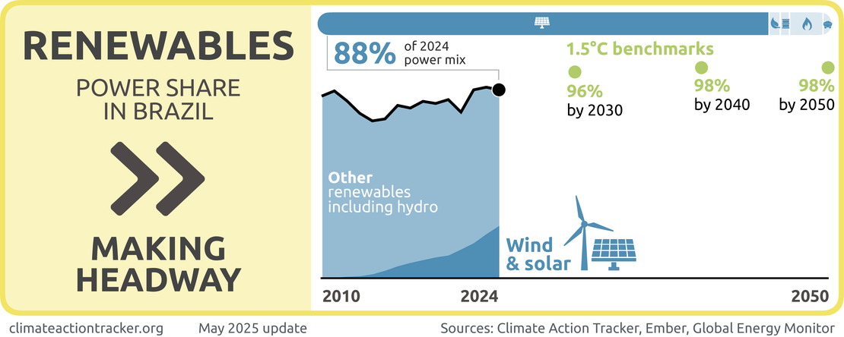
Brazil
Coal only 2% of power generation and decreasing share BUT Brazil plans to expand coal capacity & no coal phase-out target.
Gas only 6% of power generation and decreasing share BUT Brazil plans to significantly expand fossil gas capacity & no gas phase-out target
1.5C compatible, coal phase-out by 2030 & gas phase-out by 2035
Renewables consistently over 80% of power generation. Wind and solar steep increase from 11% in 2020 to 25% in 2024.
Notes:
There are 41 GW of fossil gas and oil power plants, either announced or in pre-construction phase in Brazil, with over 4 GW currently under construction (Global Energy Monitor, 2024).

Slide 19

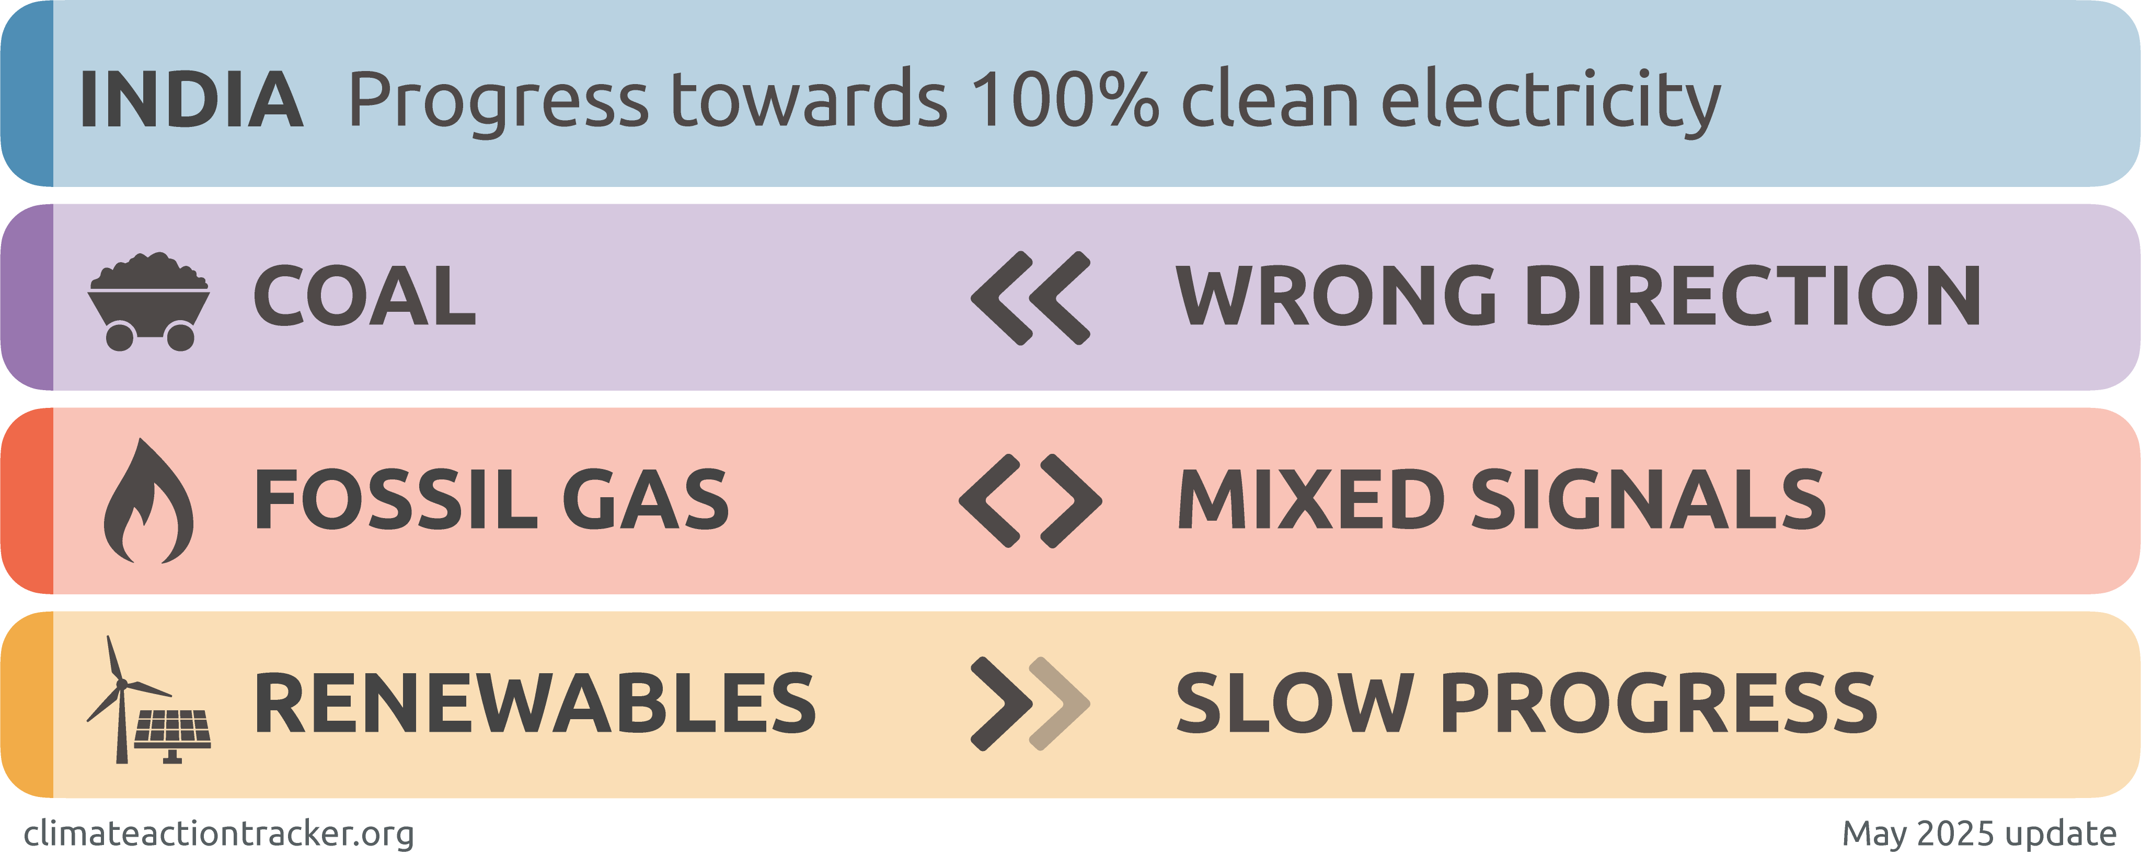
India
Steep increase in electricity demand but coal in power generation has stayed around 75%

Slide 20
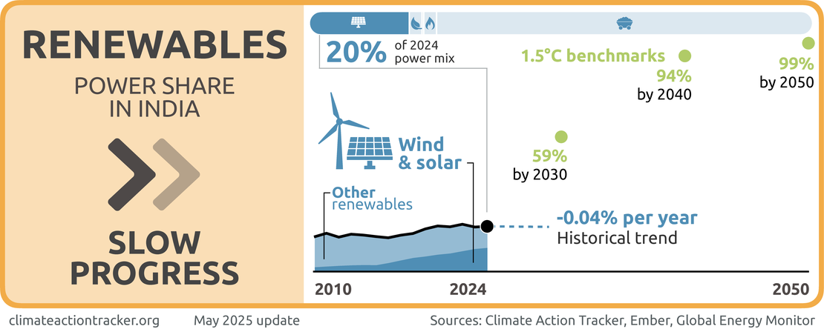
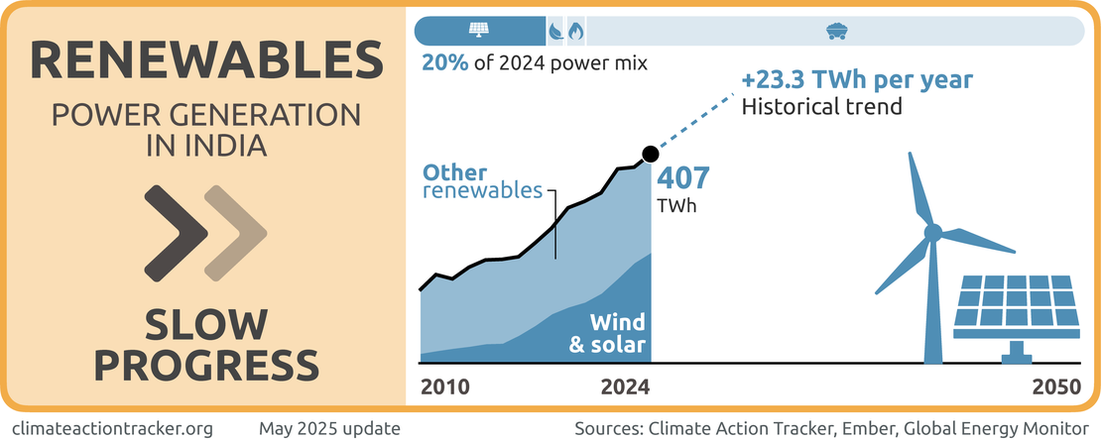
India
Power generated from coal in absolute terms significantly increased, though share about 75%. No coal-phase target & significant capacity planned
Share of fossil gas small and decreasing BUT planned capacity additions and not phase-out target
1.5C compatible effective coal phase-out by 2040 & effective gas phase-out by 2040
Significant progress in renewable energy deployment BUT capacity addition not reflected in generation
India will need international support to achieve a transition at this scale
Notes:
The reasons for low renewable power generation despite high generation capacity are manyfold. Rapid electricity demand growth means that fossil fuels are still needed to meet a significant portion of the increased demand, keeping their overall share high relative to renewables in the total mix. In 2024, for the first time more than 50% of the demand growth has been met through non-fossil sources.
There are also weather-related factors that have caused lower renewables power generation. Storage capacity is still limited, and night demand is mainly met through fossil sources. Lower solar radiation than expected has meant that solar generation has not fully reflected the impact of the generation capacity boom. Wind generation is affected by variable wind conditions year to year. Hydropower generation is significantly affected by drought conditions, though India saw a rebound in hydro in 2024 after a decline in 2023.

Slide 21

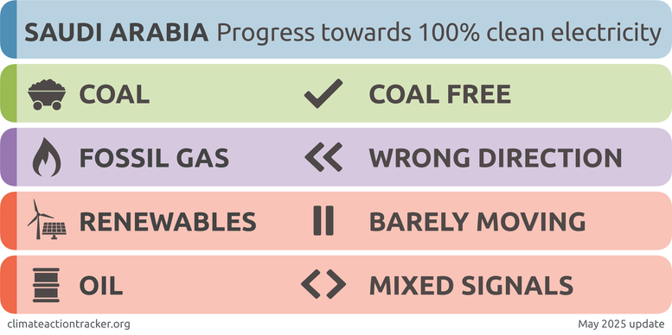
Saudi Arabia
Share of oil in power mix at 36% so we evaluate it

Slide 22
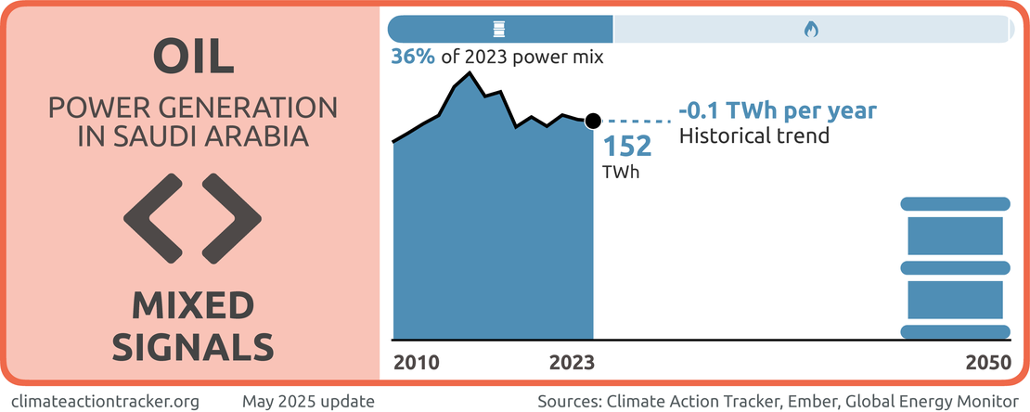

Saudi Arabia
No coal in power generation in last 15 years
Share of gas stagnant in last 5 years, but absolute generation has increased. Aiming for 50% of total electricity generated with fossil gas by 2030
Renewables at 1% and deployment far too slow to meet the Kingdom’s latest 2030 target of 50%
Share of oil in the power mix decreased from 55%-36% over last five years, absolute amount of oil generation remained stagnant. Off track to phase out oil by in power sector by 2030

Slide 23
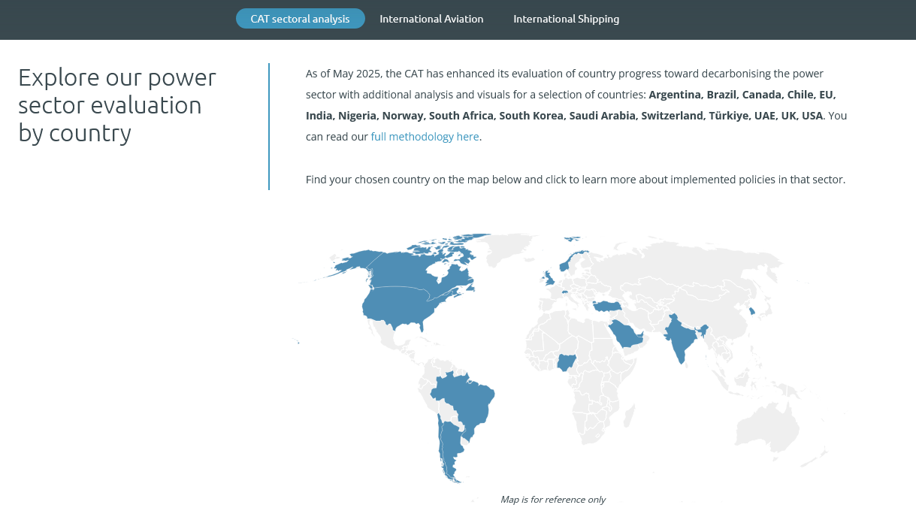
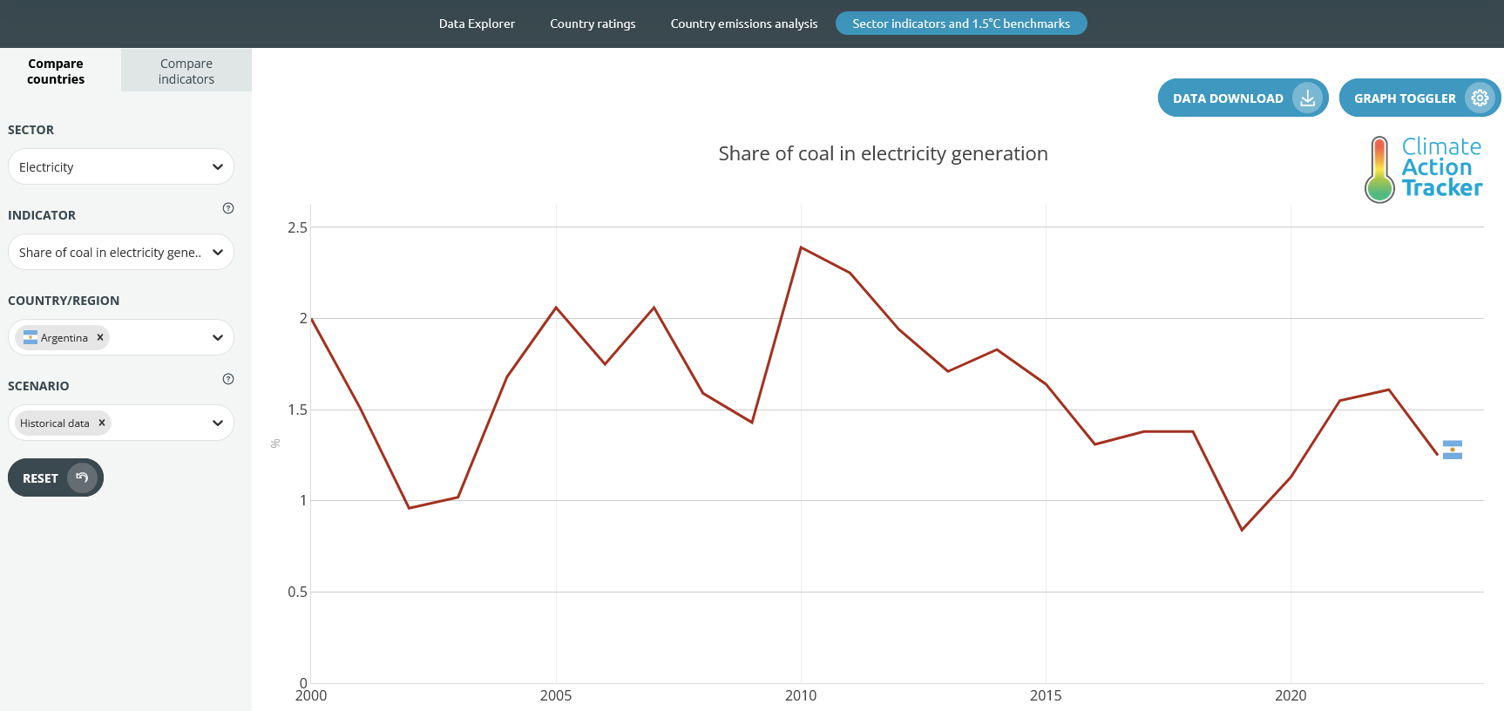
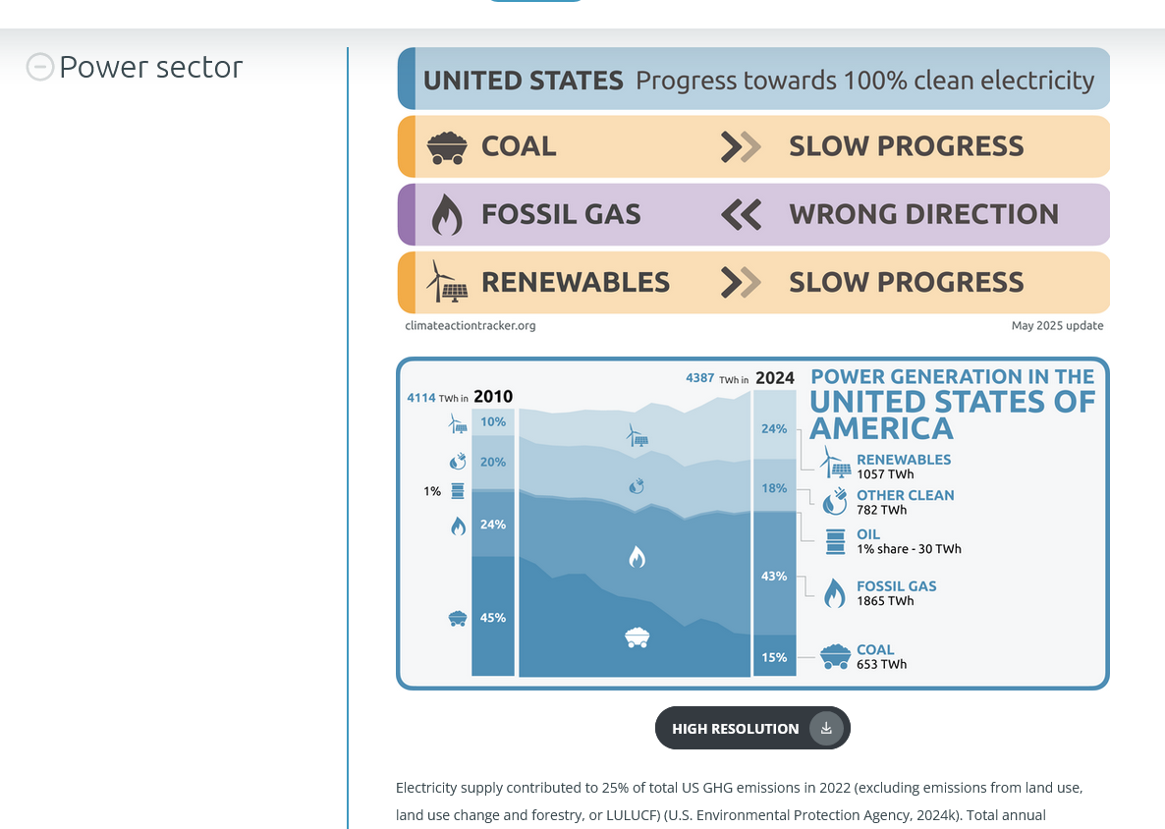
Climate Action Tracker’s sectoral work

Slide 24

You can find all
power sector evaluations
on our website:
climateactiontracker.org/sectors/cat-sectoral-analysis/

